Slide 1
Certification in Advanced Tech Service Engineering
Proactive Monitoring Case Study
TSE Advanced Batch 2
Atul Pahlazani
03-OCT-23

Slide 2
Plan
Introduction
Proactive Monitoring overview
Introduction to case study
Case study solution design
Case study solution implementation
Learnings & enhancements
What extra has been implemented in the case study

Slide 3

Introduction
Atul Pahlazani
Systems Engineer III
Compute

Slide 4
Proactive Monitoring overview
Proactive monitoring is a proactive IT management approach that aims to identify and address issues before they impact system performance or availability. Enhance system reliability: Proactive monitoring helps minimize downtime by identifying potential problems early. Improve performance: It ensures systems operate at peak efficiency. Alerting Systems: Set up alerts for specific thresholds to notify IT teams of potential issues.
Predictive Analytics: Use historical data to predict and prevent future problems.
Benefits Reduced Downtime: Minimize the impact of system outages by addressing issues proactively.
Better User Experience: Ensure a smoother experience for customers and end-users.
Cost Savings: Reduce emergency IT costs and the expenses associated with system failures.
Implementation StepsDefine Metrics: Determine what aspects of your systems need monitoring and what thresholds are critical. Establish Workflows: Create procedures for addressing alerts and issues identified through proactive monitoring.
Continuous Improvement: Regularly review and refine your monitoring strategy to adapt to changing needs. These points can serve as a foundation for creating a PowerPoint presentation on proactive monitoring.

Slide 5
Introduction to case study
In this case study, we prepare ourselves to solve the problem faced frequently in IT operations industry i.e., to enable proactive monitoring for IT systems
In day-to-day operations, other than solving the actual issues that are reported, we must analyze the issue proactivly.
This helps us in gathering meaningful data, with with we can streamline, finetune and improve existing process.
At my workplace, specifically in our operations team, this proactive monitoring would solve business critical down issues due to IT systems down/performance issues.
It helps to optimize out operations reporting and improve overall efficiency, minimizes the risk of reactive measures.
By automating these tasks, report automation tools free up employees’ time to concentrate on actual technical issues.
Overall, this can achieve increased efficiency and accuracy while minimizing operational expenses.

Slide 6
Case study benefits
This allows us to have full control over the reporting system/performance and customize alerts/Metrics based on needs and requirements and makes it easier to analyze data and identify trends or patterns.
Proactively predict the issues before the users report.

Slide 7
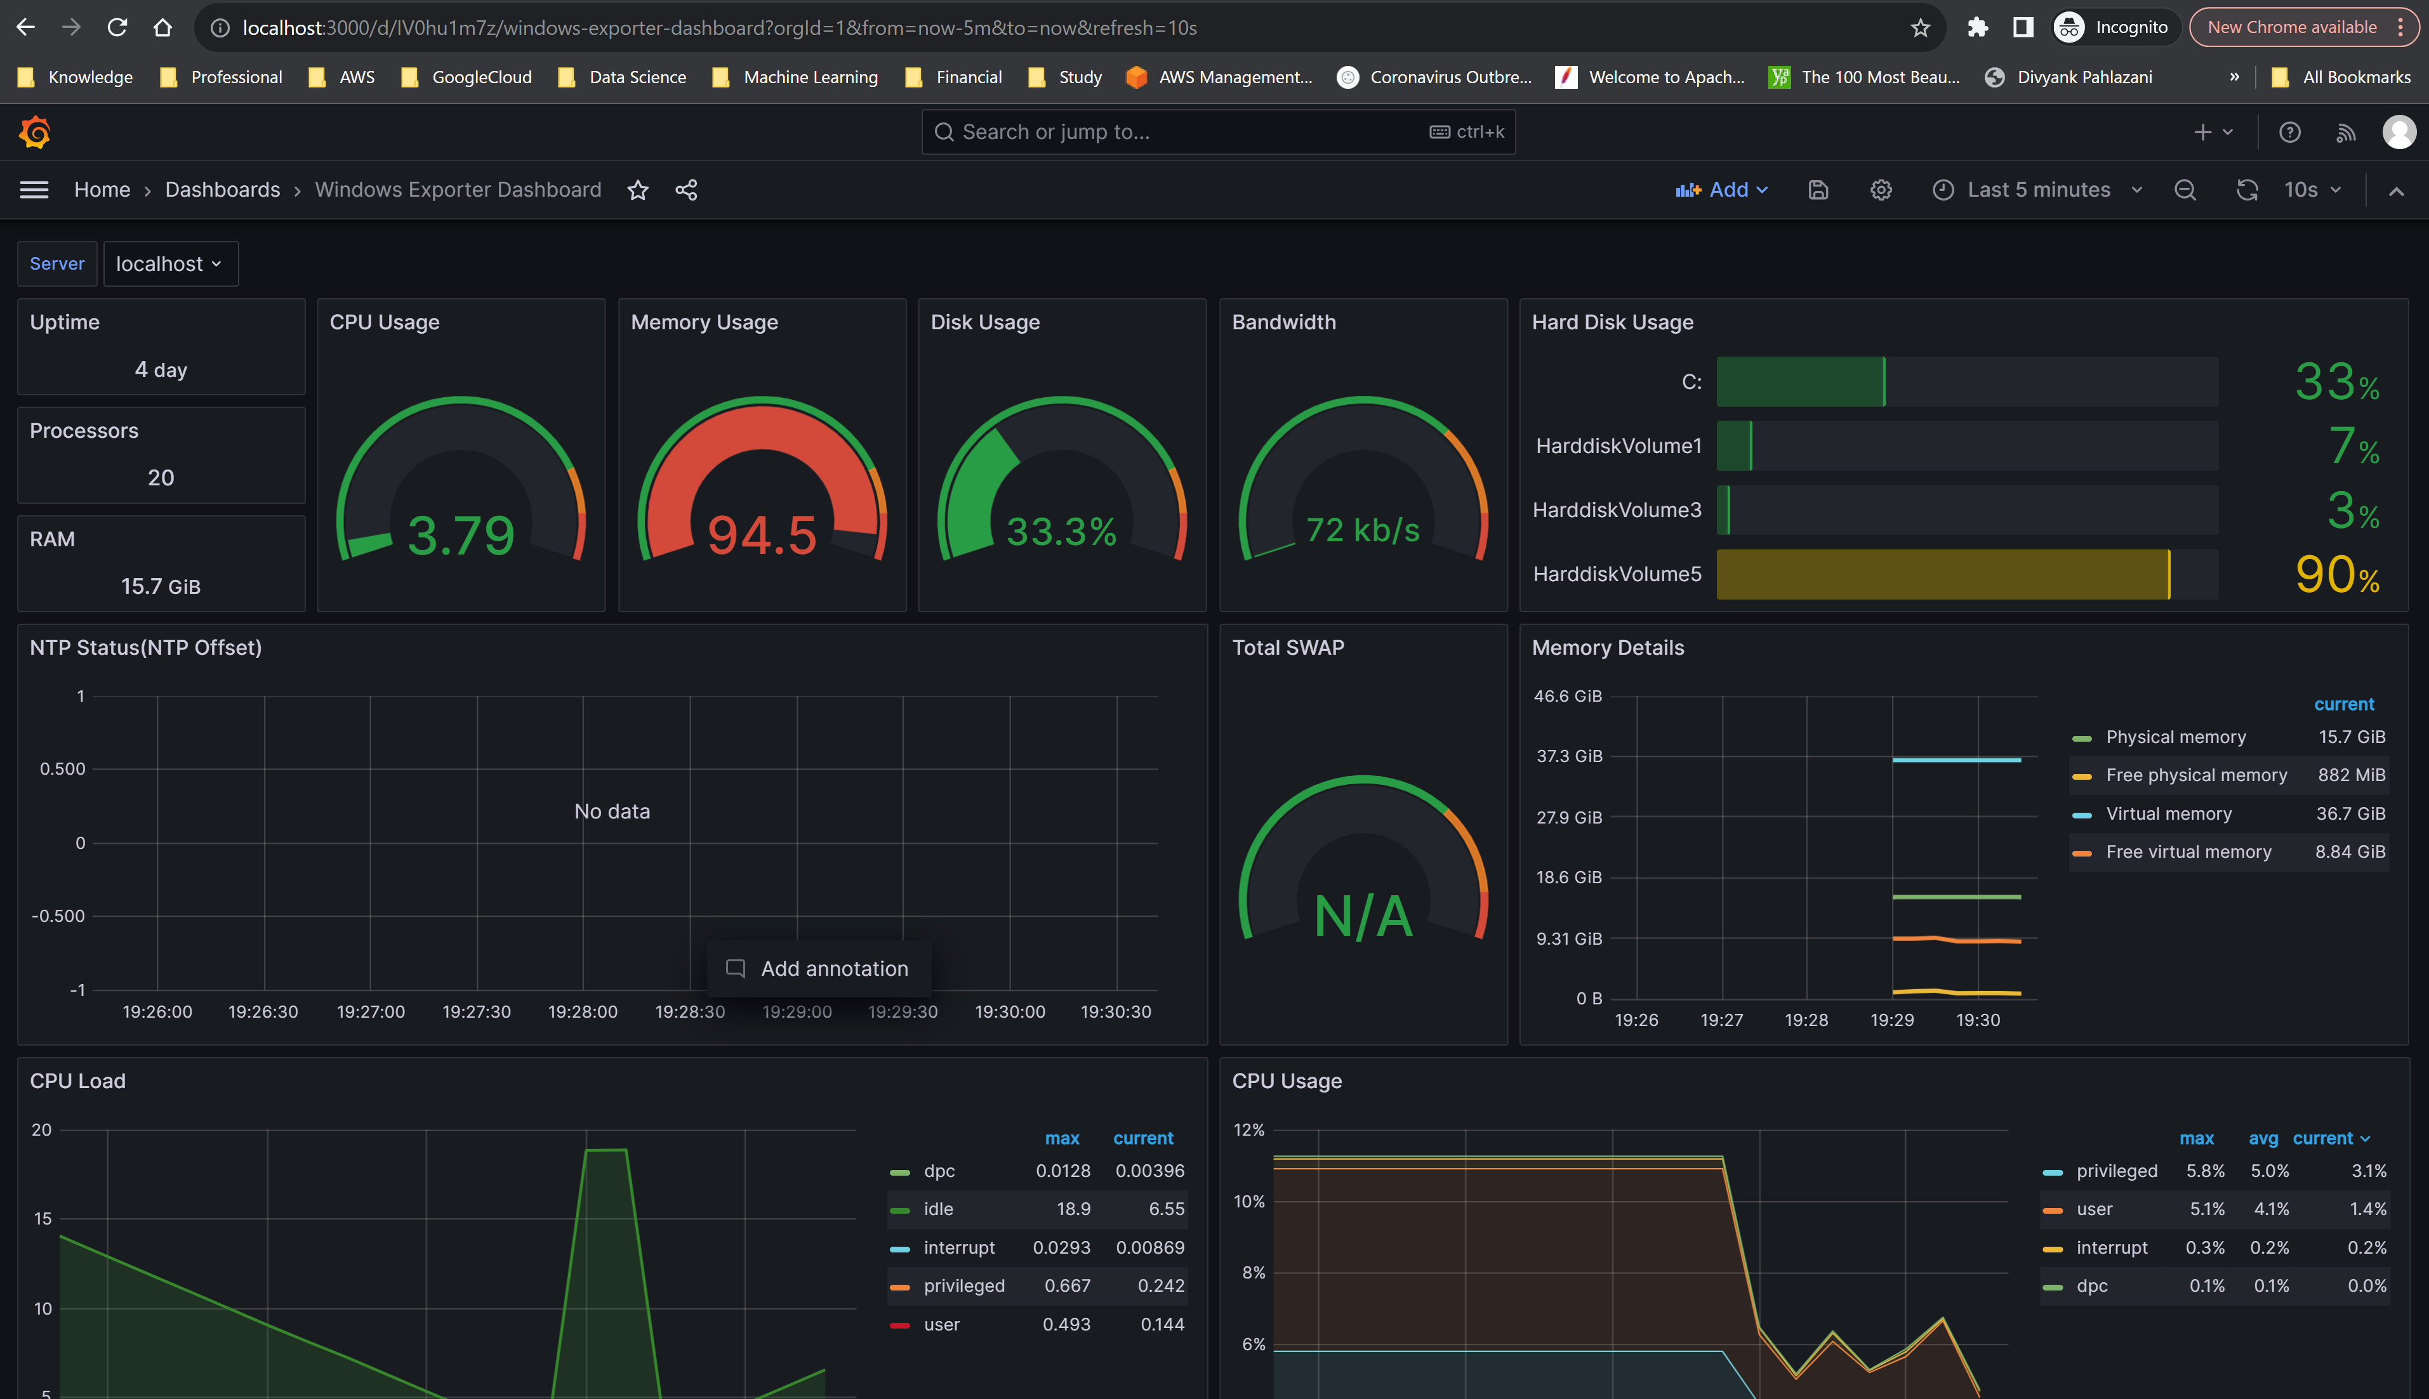
Case study solution design
Server uptime and other OS metrics dashboard

Slide 8
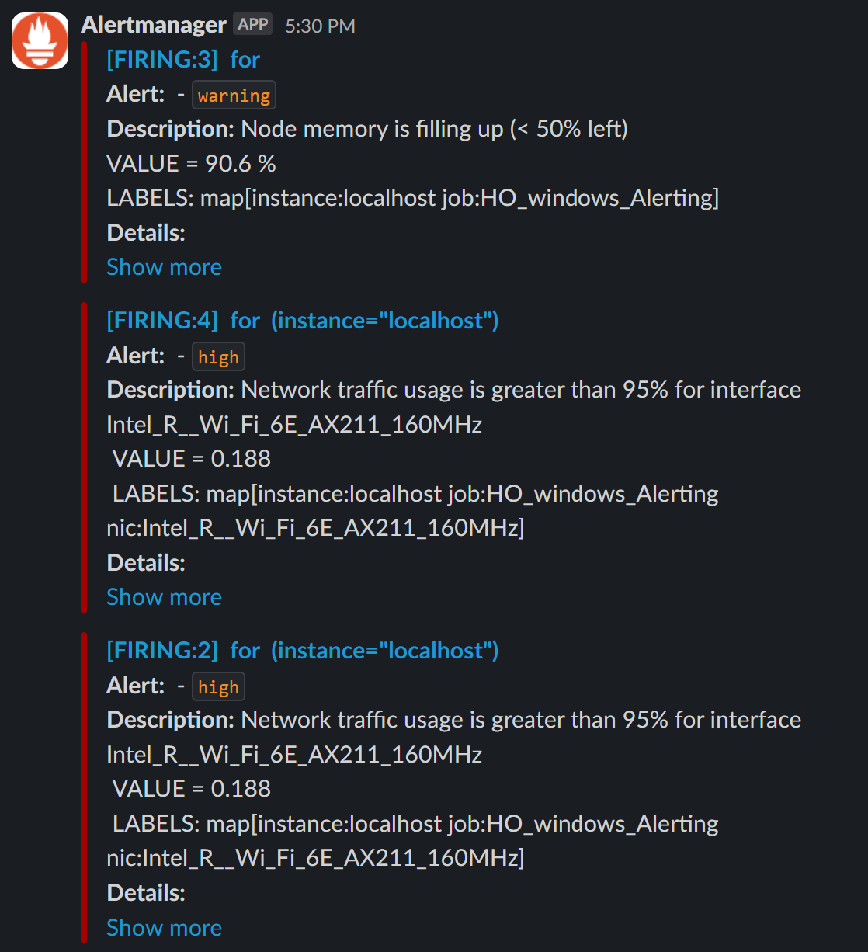
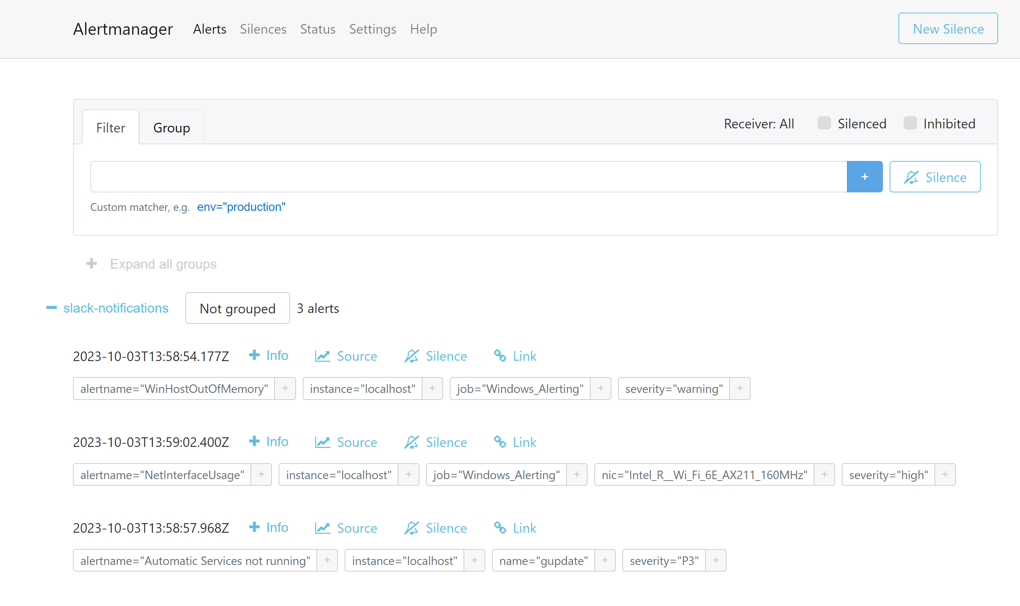
Case study solution implementation
Alert notifications to Slack example
Alerts related to server memory/windows services from Prometheus to Alert Manager

Slide 9
Case study solution implementation
Grafana dashboard

Slide 10
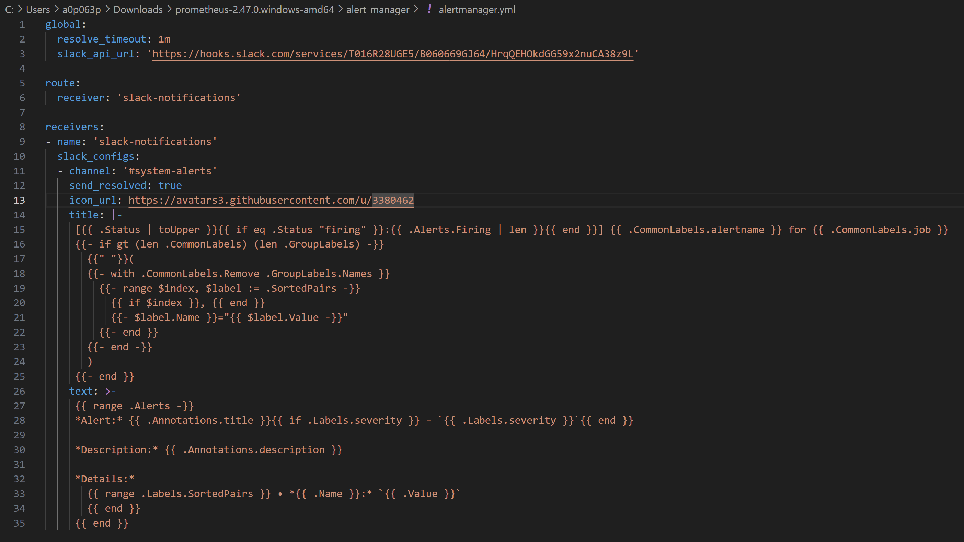
Case study solution implementation
Alertmanager.yml

Slide 11
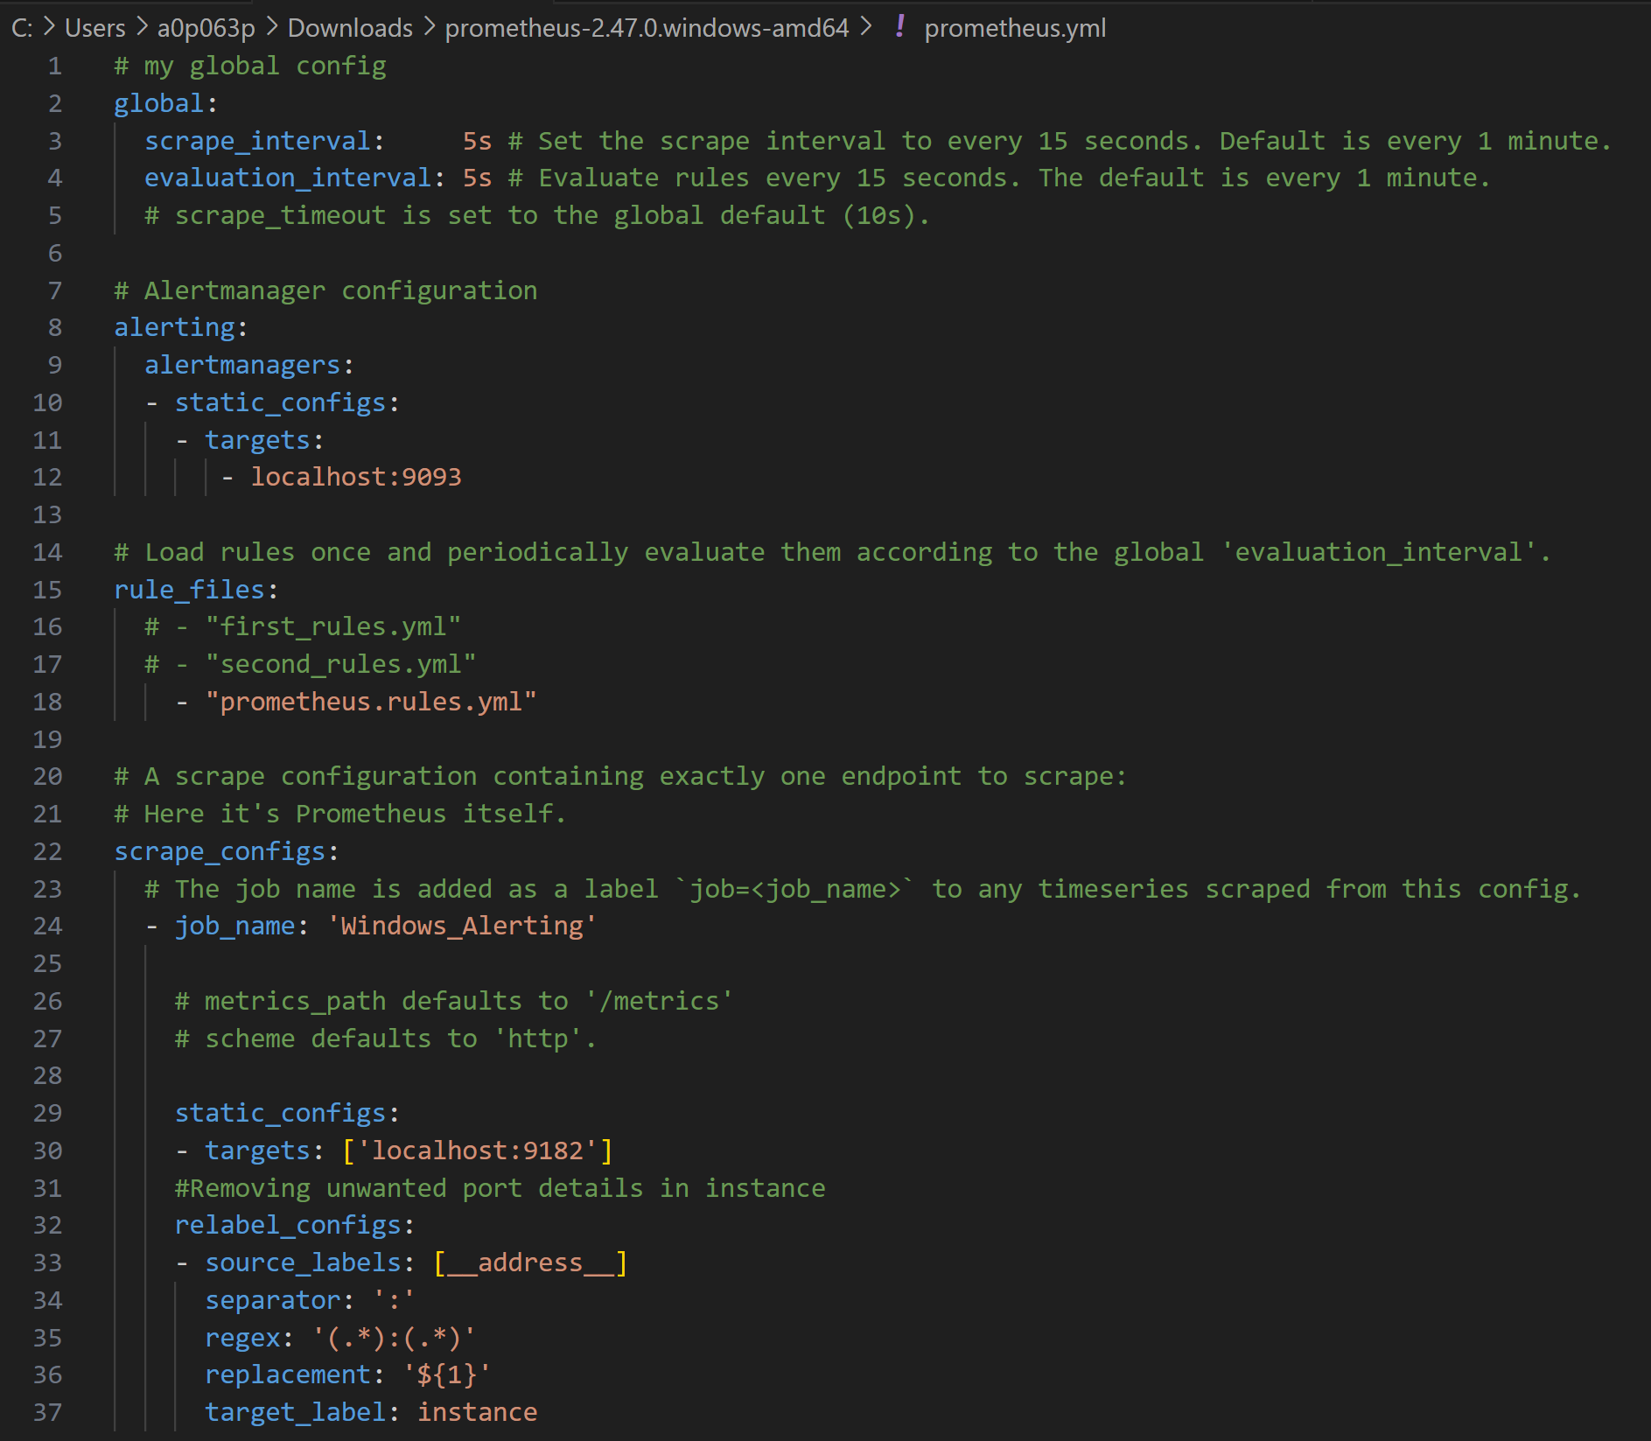
Case study solution implementation
Prometheus config file

Slide 12
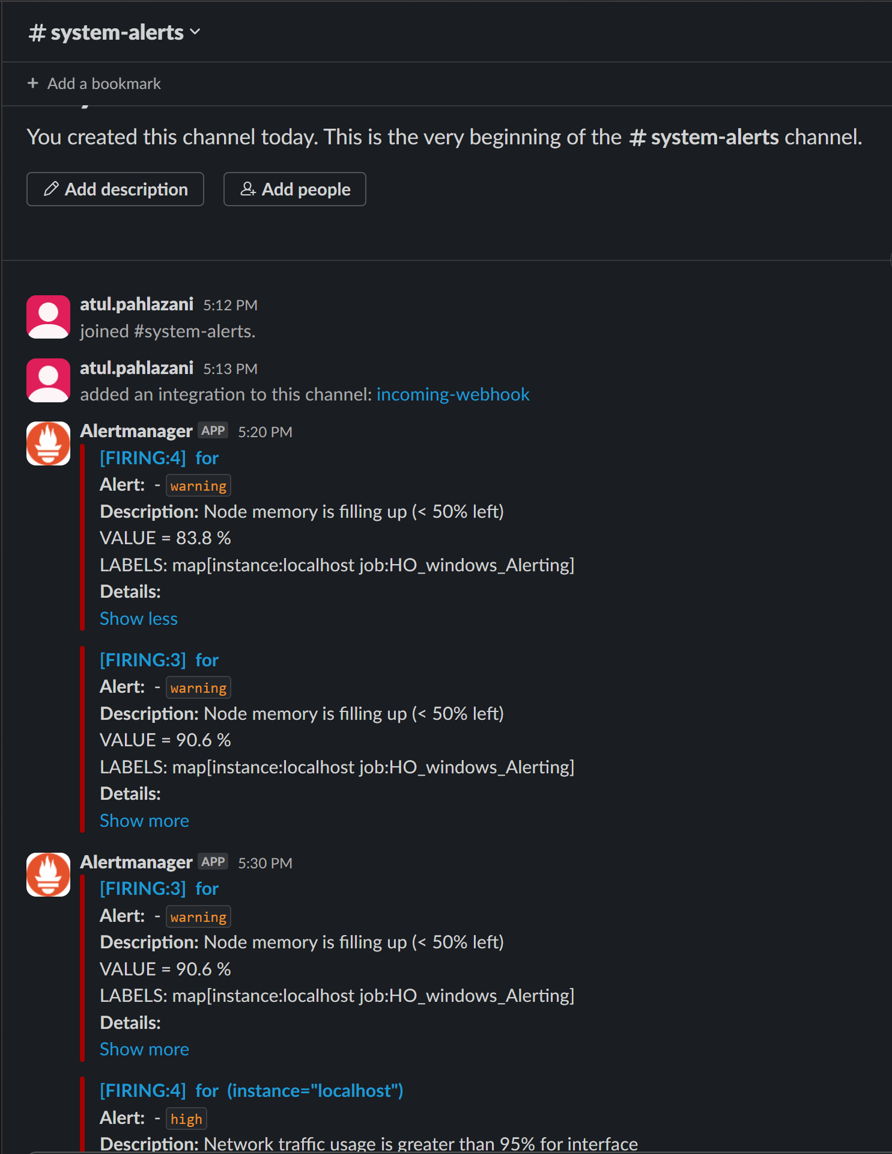
Case study solution implementation
Slack alert example

Slide 13
Learnings & enhancements
I learnt several integrations that can be done between various tools such as slack, prometheus, Grafana.
Had to check the available list of activities for each tool. This exploration will help in future as well for other projects as well.
This integration with various programs, platforms, enabling smooth automation across different systems. This platform-agnostic approach allows organizations to proactively monitor systems regardless of the underlying technology stack.

Slide 14
What has been your manager’s feedback
My Manager was glad that the case study is a great example of how Proactive monitoring can help businesses improve their operations and customer satisfaction.
He is also supportive for the implementation of such Alerting in our team to increase efficiency, accuracy and save time.

Slide 15
Thank You

